Slide 1
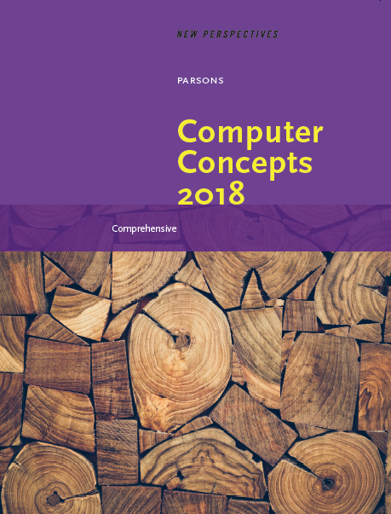

Computer Concepts 2018
Module 2 Digital Devices
Copyright © 2019 Cengage. All rights reserved.

Slide 2
Module Contents
Section A: Device Basics
Section B: Device Options
Section C: Processors and Memory
Section D: Storage
Section E: Input and Output

Slide 3
Section A: Device Basics
Computers
Circuits and Chips
Components
Maintenance

Slide 4
Section A: Objectives (1 of 2)
Draw a diagram showing the IPOS model of activities characteristic of computers
Describe the stored program concept and why it distinguishes computers from other simpler and less versatile digital devices
State which of the following are application software and which are system software: iOS, Windows, Microsoft Word, Android, PowerPoint

Slide 5
Section A: Objectives (2 of 2)
List three terms that are commonly used alternatives for “integrated circuits”
Explain why semiconductors are the materials used for integrated circuits
Identify the microprocessor on a system board
Identify the components of a typical device that has a component, clamshell, or slate form factor

Slide 6
Section B: Objectives
List four mistakes to avoid when cleaning a digital device
Describe what to do if liquid is spilled on a device
Explain how to care for a touchscreen
List six steps to take to increase battery life and lifespan

Slide 7
Computers (1 of 7)
At its core, a computer is a multipurpose device that accepts input, processes data, stores data, and produces output, all according to a series of stored instructions
Input is whatever is typed, submitted, or transmitted to a computer
Output is the result produced by a computer
Computers process data by performing calculations, modifying documents and pictures, drawing graphs, and sorting lists of words or numbers
Processing is handled by the computer’s central processing unit (CPU)

Slide 8
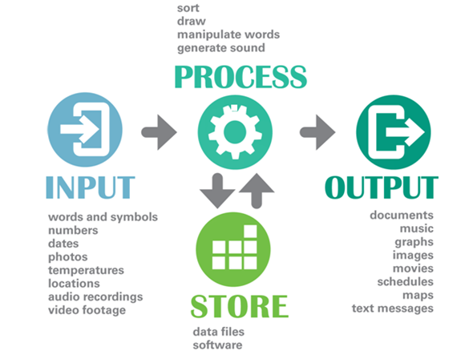
Computers (2 of 7)
Notes:
Figure 2-1

Slide 9
Computers (3 of 7)
The instructions that tell a digital device how to carry out processing tasks are referred to as a computer program, or simply a program
Programs form the software that sets up a computer to do a specific task

Slide 10
Computers (4 of 7)
When a computer “runs” software, it performs the instructions to carry out a task
The first computers were “programmed” to perform a specific task by connecting wire circuitry in a certain way
The term stored program means that a series of instructions for computing a task can be loaded into a computer’s memory

Slide 11
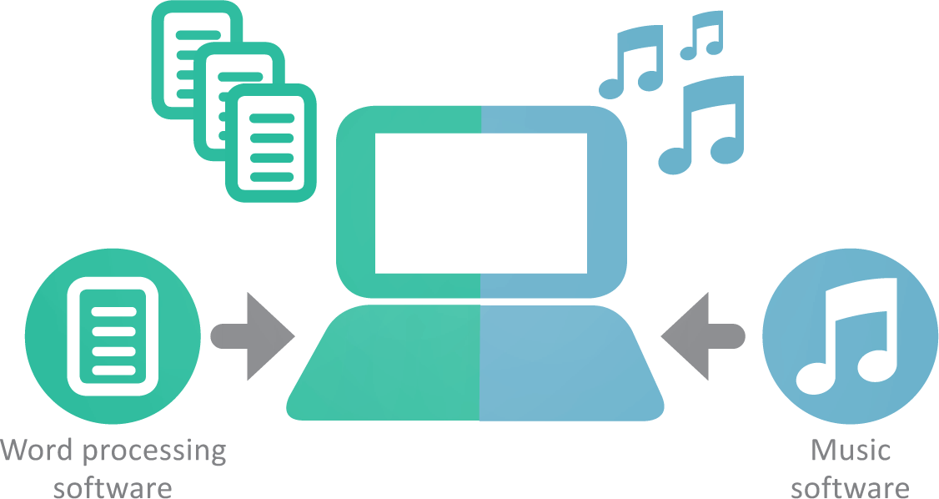
Computers (5 of 7)
The stored program concept allows you to use a computer for one task, such as word processing, and then easily switch to a different type of computing task, such as editing a photo or playing music. It is the single most important characteristic that distinguishes computers from other simpler and less versatile digital devices, such as digital clocks, calculators, and cameras.

Slide 12
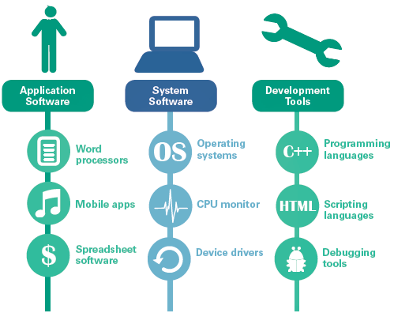
Computers (6 of 7)
Computers run three main types of software:
Application software
System software
Development tools

Slide 13
Computers (7 of 7)
Application software is a set of computer programs that helps a person carry out a task
The primary purpose of system software is to help the computer system monitor itself in order to function efficiently (an example of system software is a computer operating system or OS)
Development tools are used for creating software applications, Web sites, operating systems, and utilities

Slide 14
Circuits and Chips (1 of 7)
The small circuit boards and integrated circuits you see when you open up a digital device are the essence of digital electronics
Digital electronics represent data bits as electrical signals that travel over circuits in much the same way that electricity flows over a wire when you turn on a light switch

Slide 15
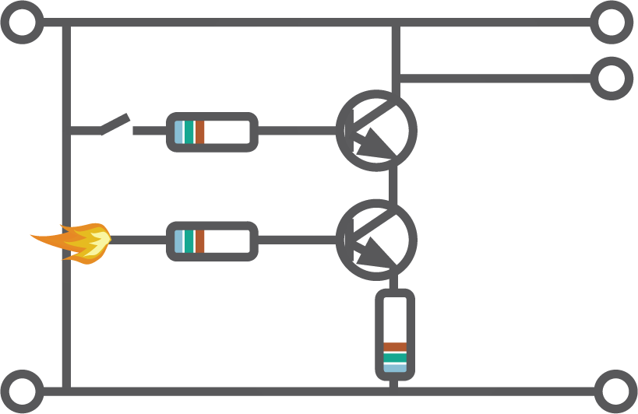
Circuits and Chips (2 of 7)
This little circuit is composed of electrical pathways (lines), transistors (circles), and resistors (rectangle). The electronics for digital devices require millions of similar circuits. Today, this circuitry is condensed into integrated circuits.

Slide 16
Circuits and Chips (3 of 7)
An integrated circuit (IC) is a set of microscopic electronic circuits etched onto a thin slide of semiconducting material
The terms computer chip, microchip, and chip are commonly used to refer to integrated circuits
Semiconductors, such as silicon and germanium, are substances with properties between those of a conductor (like copper) and an insulator (like wood)

Slide 17
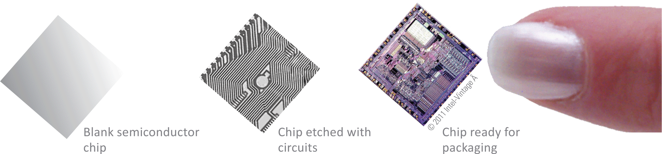
Circuits and Chips (4 of 7)

Slide 18
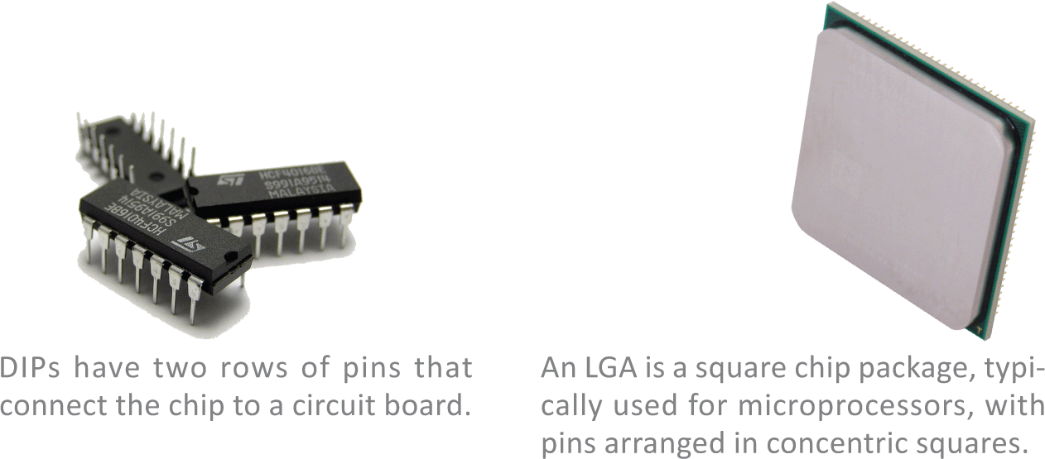
Circuits and Chips (5 of 7)

Slide 19
Circuits and Chips (6 of 7)
The electronic components of most digital devices are mounted on a circuit board called a system board, motherboard, or main board
The system board houses all essential chips and provides connecting circuitry between them

Slide 20
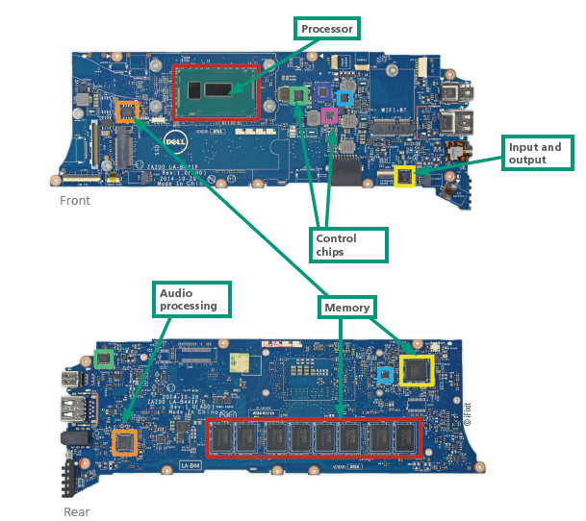
Circuits and Chips (7 of 7)

Slide 21
Components (1 of 4)
In the computer industry the term form factor refers to the size and dimensions of a device or components, such as circuit boards and system units
The term system unit is tech speak for the part of a digital device that holds the system board
Some popular form factors include: component, clamshell, and slate

Slide 22
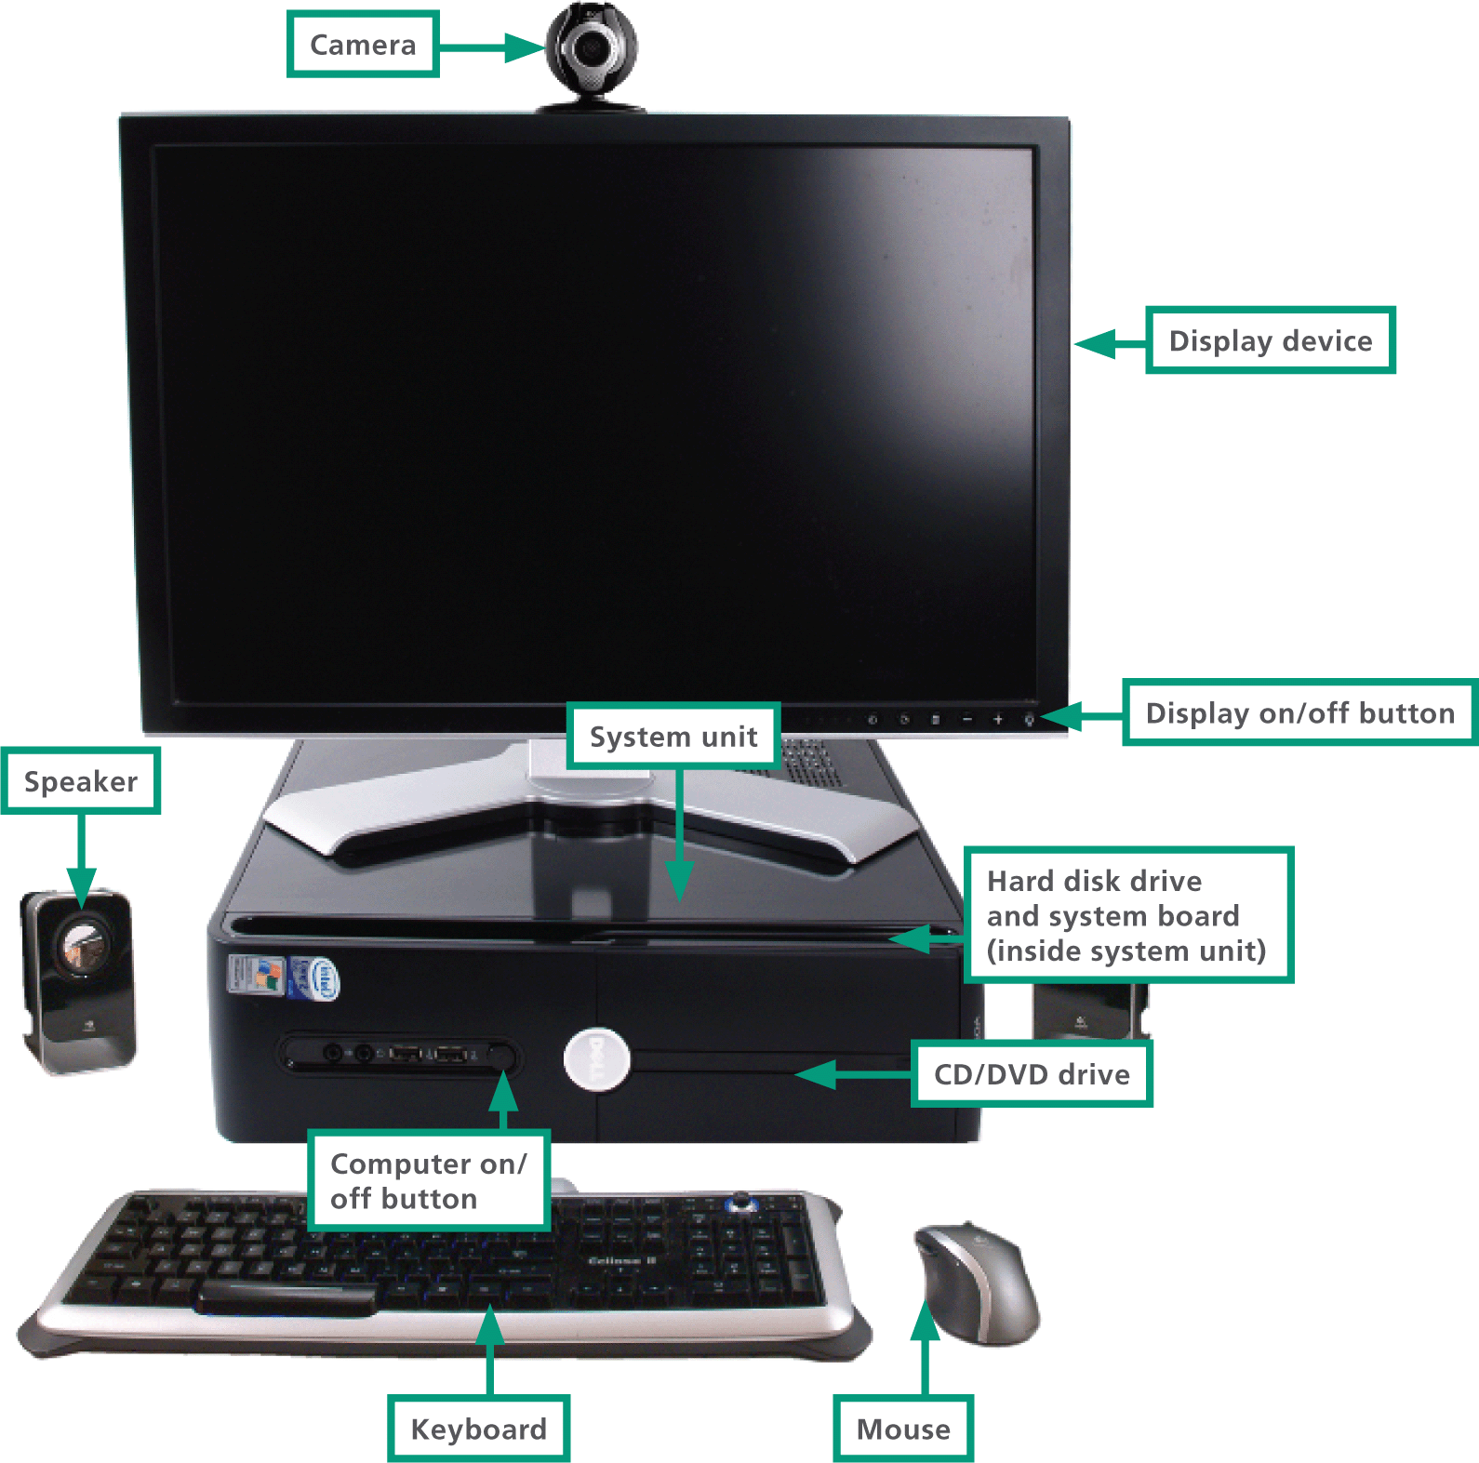
Components (2 of 4)

Slide 23
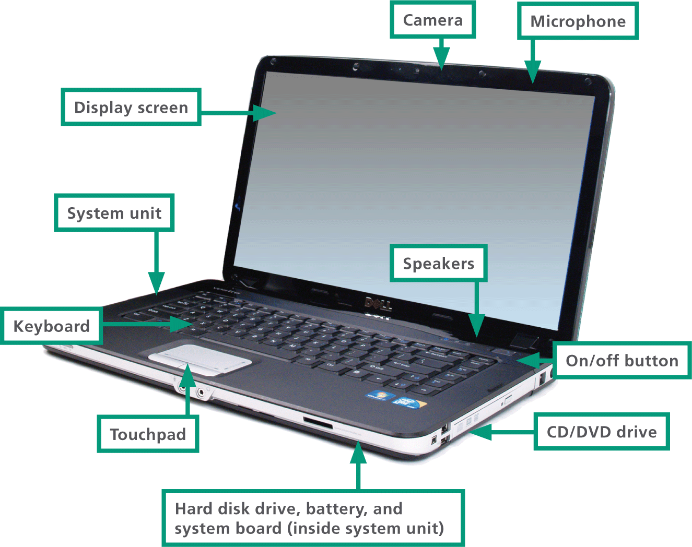
Components (3 of 4)

Slide 24
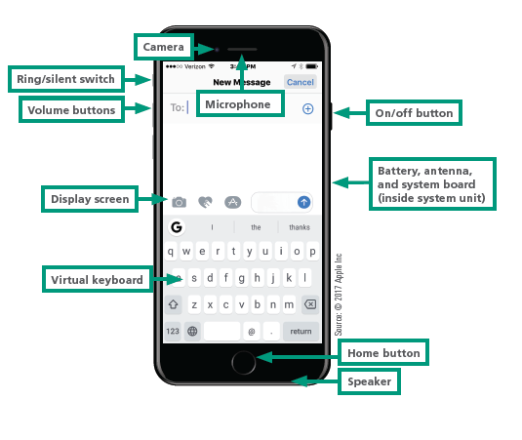
Components (4 of 4)

Slide 25
Maintenance (1 of 6)
You can extend the life of your digital devices with regular maintenance
There are four components of digital devices that require maintenance:
System unit
Keyboard
Screen
Battery

Slide 26
Maintenance (2 of 6)
Don’t use harsh cleaning products; follow manufacturer recommendations.
Never immerse a device in liquid; water and electronics don’t mix.
Do not allow cleaning agents to drip on keyboards or touchpads.
Do not spray cleaning agents directly on the device; spray them onto a cleaning cloth.

Slide 27
Maintenance (3 of 6)
Basic system unit maintenance is simple; keep the unit clean, prevent it from overheating, shield it from damage, and protect it from electrical surges
Dust with a clean microfiber cloth and disinfect with antibacterial wipes.
Use a low vacuum setting to remove dust from fan vents.
Use a protective case or carrying bags.
Only plug into a surge-protected outlet.

Slide 28
Maintenance (4 of 6)
Touchscreens collect fingerprints and are a breeding ground for bacteria, so it’s a good idea to clean them periodically
Many touchscreens are made from Gorilla Glass, which is designed to resist scratching and cracking, and oleophobic coating, designed to repel oils from fingertips
A plastic screen protector is a good defense against scratches and cracks.

Slide 29
Maintenance (5 of 6)
Most of today’s battery-powered digital devices contain a lithium ion (Li-ion) battery
Li-ion batteries can overheat, and in the worst case, they can explode
Smart consumers don’t operate devices that are hot to the touch

Slide 30
Maintenance (6 of 6)
Charge when the low battery indicator comes on.
Avoid totally discharging the battery.
Remove the device from the charger when it’s fully charged.
If your device becomes hot while in use, turn it off.
Disable unused apps that constantly connect to the internet.
Switch to the airplane mode when in area with no cell coverage.

Slide 31
Section B: Device Options
Enterprise Computers
Personal Computers
Niche Devices
Choosing a Digital Device

Slide 32
Section B: Objectives
List three types of computers that are commonly used in businesses, serve multiple simultaneous users, and offer very fast processing speeds
Draw a hierarchy chart showing the classifications of personal computers
List two applications that would tend to require a desktop computer
List the devices that typically support cellular voice and texting. List devices that can support cellular data plans
Specify three operating systems that are common in each of the following categories: desktops, laptops, tablets, and smartphones.

Slide 33
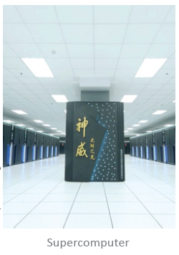
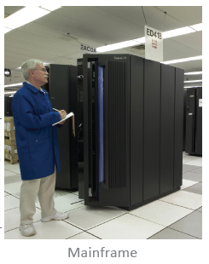
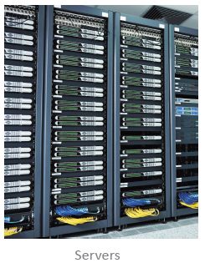
Enterprise Computers (1 of 2)
The most powerful computers are generally used in businesses and government agencies
These computers have the ability to service many simultaneous users and process data at very fast speeds
Types of “Big” computers are:
Supercomputers
Mainframes
Servers

Slide 34
Enterprise Computers (2 of 2)
Supercomputers: considered the fastest computers in the world at the time of construction; can tackle complex tasks other computers cannot; typical use includes breaking codes, modeling weather systems, and simulating nuclear explosions
Mainframes: a large and expensive computer capable of simultaneously processing data for hundreds or thousands of users; looks like a closet-sized cabinet; used to provide centralized storage, processing, and management for large amounts of data
Servers: “serves” data to computers in a network; Google search results are provided by servers; about the size of a desk draw and mounted in racks of multiple servers

Slide 35
Personal Computers (1 of 3)
A personal computer is designed to meet the computing needs of an individual
The term personal computer can be abbreviated as PC
Personal computers can be classified as:
Desktops
Portables
Laptops
Tablets
Smartphones

Slide 36
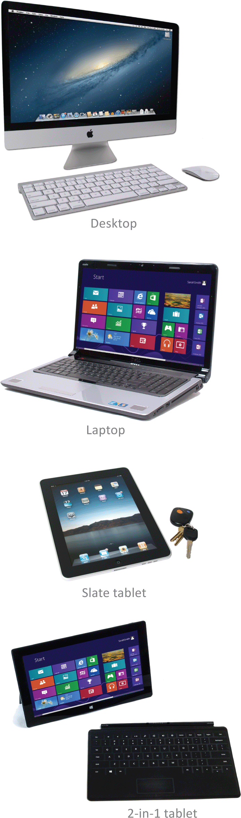
Personal Computers (2 of 3)
Desktops: fit on a desk and run on power from a wall outlet; keyboard is typically separate from the monitor; popular in offices and schools
Portables: run on battery power; their components are contained in a single case for easy transportation
Laptops: also referred to as a notebook computer; small and lightweight with a clamshell design and keyboard at the base

Slide 37
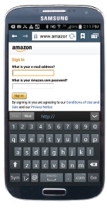
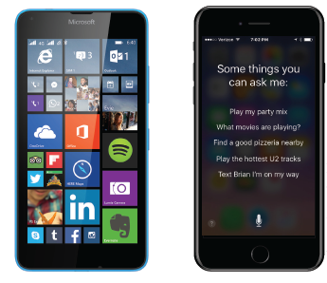
Personal Computers (3 of 3)
Tablets: a tablet computer is a portable computing device featuring a touch-sensitive screen used for input and output; uses a specialized OS; a slate tablet configuration has a narrow frame screen that lacks a physical keyboard; Apple iPad is a slate tablet
Smartphones: mobile devices with features similar to a tablet computer; provide telecommunications capabilities over cell phone networks

Slide 38
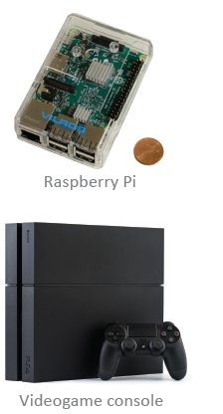
Niche Devices (1 of 2)
Niche devices all have one thing in common: They contain a microprocessor
Raspberry Pi: Just a tad larger than a deck of cards; the Raspberry Pi can be connected to a keyboard and screen for a full computer experience
Portable media players: are handheld devices that can store and play music; iPod touch is a portable media player

Slide 39
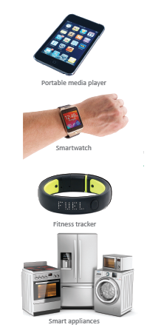
Niche Devices (2 of 2)
Smartwatches: multifunctional devices that include a camera, thermometer, compass, calculator, cell phone, GPS, media player, and fitness tracker
Activity trackers: monitor your steps and heart rate
Smart appliances: modern refrigerators, washing machines, and other appliances are controlled by integrated circuits called microcontrollers that combine sensors with processing circuitry

Slide 40
Choosing a Digital Device (1 of 6)
The following activities can get you started on choosing the right digital device:
Consider how you plan to use your device
Choose the type of device
Decide on a budget and stick to it
Select a platform
Check out the device’s specifications

Slide 41
Choosing a Digital Device (2 of 6)
Usage Plan | Purchase Recommendation
You plan to use your computer for email and Facebook, browsing the Web, playing games, managing finances, downloading digital music, and writing school papers. | A mid-priced computer with standard features might meet your needs.
You’re buying a new computer to replace an old one. | If you have a big investment in software, you should select a new computer that’s compatible with the old one.
You plan to work on accounting and budgeting for a small business. | Consider one of the business systems offered by a local or an online computer vendor.
You spend lots of time playing computer games. | Buy a computer with the fastest processor and graphics card you can afford.
You plan to work extensively with video editing or desktop publishing. | Select a computer system with a fast processor, lots of hard disk capacity, a large screen, and a graphics card loaded with memory.
Someone who will use the computer has special needs. | Consider purchasing appropriate adaptive equipment, such as a voice synthesizer or onehanded keyboard.
You plan to use specialized peripheral devices. | Make sure the computer you purchase can accommodate the devices you plan to use.
Your work at home overlaps your work at school or on the job. | Shop for a computer that’s compatible with the computers you use at school or work.
You want to work with specific software, such as a 3-D graphics tool. | Select a computer that meets the specifications listed on the software box or Web site.

Slide 42
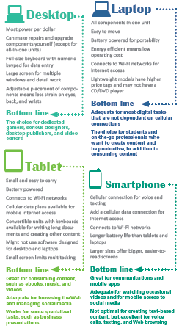
Choosing a Digital Device (3 of 6)
The most popular digital devices are desktops, laptops, tablets, and smartphones

Slide 43
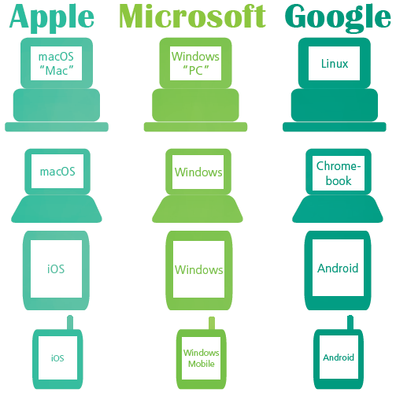
Choosing a Digital Device (4 of 6)
Computers that operate essentially the same way and use the same software are said to be compatible or having the same “platform”
You can assess whether two computers are compatible by checking their operating systems

Slide 44
Choosing a Digital Device (5 of 6)
Prices for digital devices can vary and depend on screen size, microprocessor size, and memory:
The price tag for a smartphone is $200–$900
Tablet computer prices range from $200 and $1,200
Desktop and laptop computers usually cost a little more, with price points roughly grouped into three categories:
Above $1,200
$500 – $1,200
Under $500

Slide 45
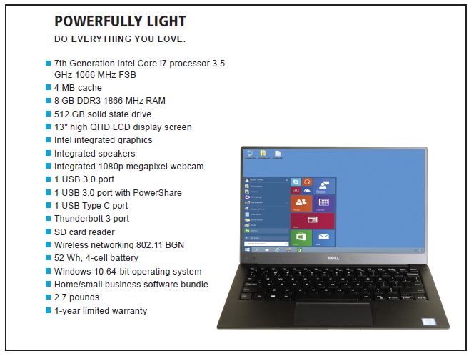
Choosing a Digital Device (6 of 6)
Computer ads are loaded with jargon and acronyms, such as RAM, ROM, GHz, GB, and USB

Slide 46
Section C: Processors and Memory
Microprocessors
How Processors Work
Performance
Random Access Memory
Read-only Memory

Slide 47
Section C: Objectives (1 of 2)
Distinguish between the x86 and ARM processor standards
Describe the significance of microprocessor instruction sets
Trace an instruction through RAM, the control unit, and ALU as it is processed
List seven factors that affect microprocessor performance
Use the pizza analogy to explain serial, pipeline, and parallel processing

Slide 48
Section C: Objectives (2 of 2)
List at least three items that would be found in RAM while you are using a digital device
List three events that occur during the boot process
Explain why digital devices have ROM in addition to RAM
List four reasons for flashing ROM

Slide 49
Microprocessors (1 of 4)
A microprocessor is an integrated circuit designed to process instructions
It is the most important, and usually the most expensive, component of a digital device
Intel Corporation is the world’s largest chipmaker and supplies a sizeable percentage of the microprocessors that power desktops and laptops

Slide 50
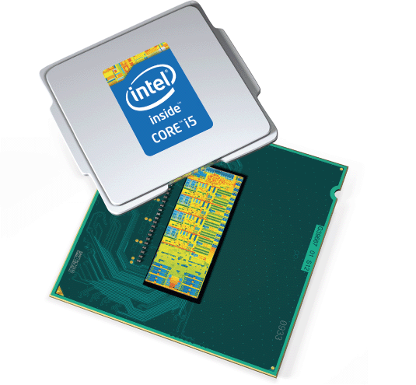
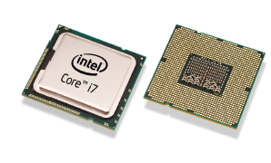
Microprocessors (2 of 4)
Intel’s 8086 family of microprocessors powered the original IBM PC
The 8086 chip family set the standard for processors used today
This standard is sometimes referred to as x86
Processors found in today’s desktops and laptops are x86 compatible

Slide 51
Microprocessors (3 of 4)
Processors based on ARM technology dominate tablet computers and smartphones
ARM technology was originally designed by ARM Holdings, a British technology company founded by Acorn Computers, Apple Inc., and VLSI Technology
ARM processors are energy efficient — an important characteristic for battery-powered devices
ARM processors are found in Microsoft’s Surface tablets, Apple’s iPads and iPhones, and Samsung’s lineup of Galaxy phones

Slide 52
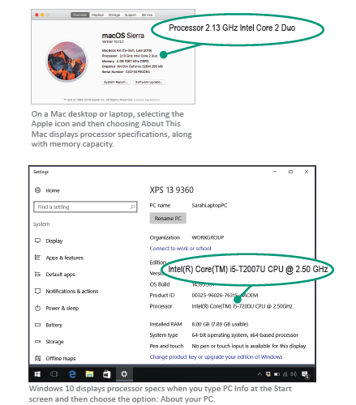
Microprocessors (4 of 4)
Finding the microprocessor that’s best for you depends on your budget and the type of work and play you plan to do
If you know the make and model of a digital device, you can generally find processor specifications by searching online

Slide 53
How Processors Work (1 of 6)
Microprocessor technology is fascinating in its ability to perform an astounding variety of tasks based on a set of really simple instructions
These instructions are referred to as an instruction set
An instruction set contains a collection of instructions for actions that the circuitry in a microprocessor can perform

Slide 54
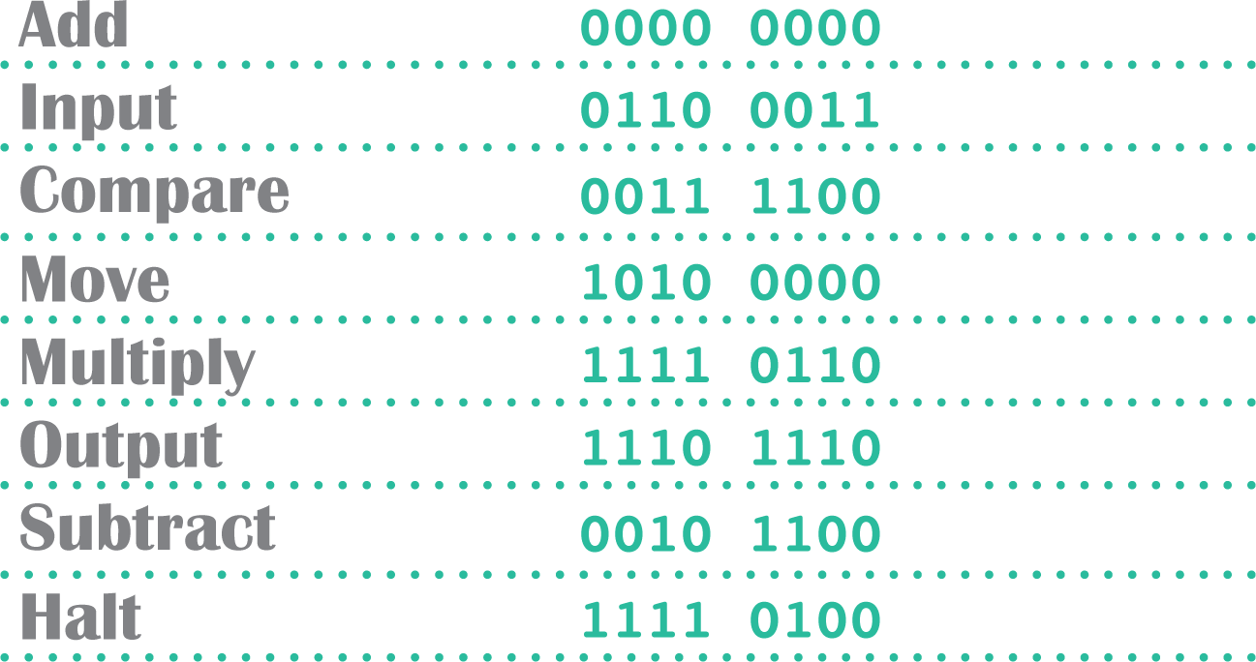
How Processors Work (2 of 6)
Microprocessors can’t directly understand programming language, such as C++, BASIC, COBOL or Java, so programs have to be converted into machine language that corresponds to the microprocessor’s instruction set

Slide 55
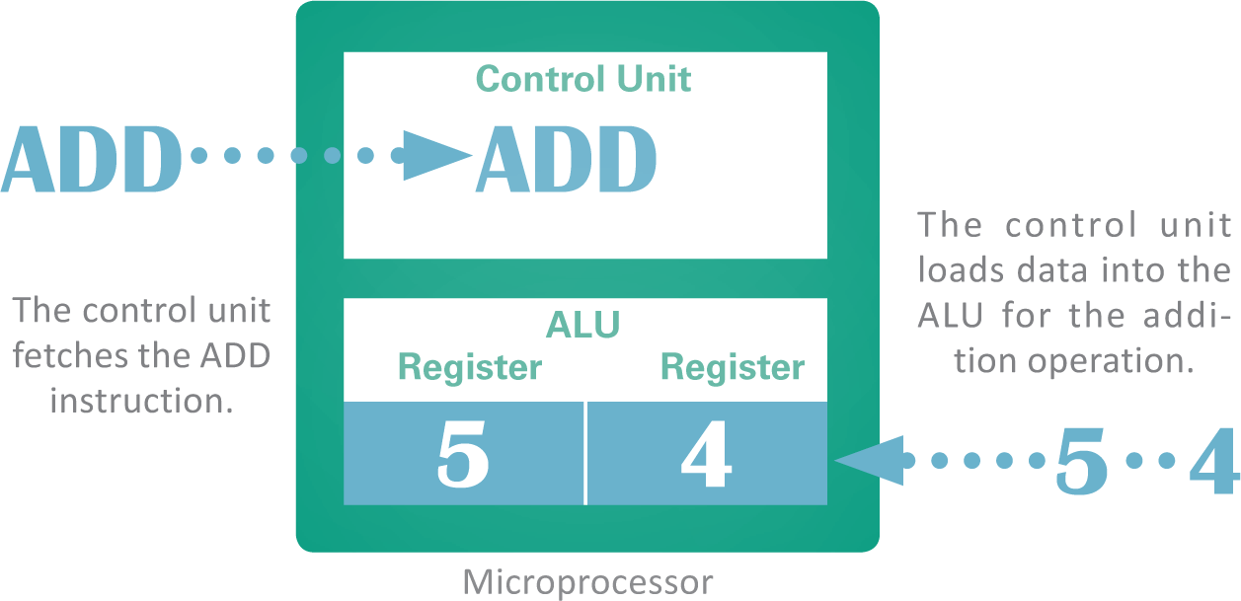
How Processors Work (3 of 6)
Operational units of the microprocessor are:
The ALU (arithmetic logic unit) is part of the microprocessor that performs arithmetic operations, such as addition and subtraction
The ALU uses registers to hold data that is being processed
The microprocessor’s control unit fetches each instruction

Slide 56
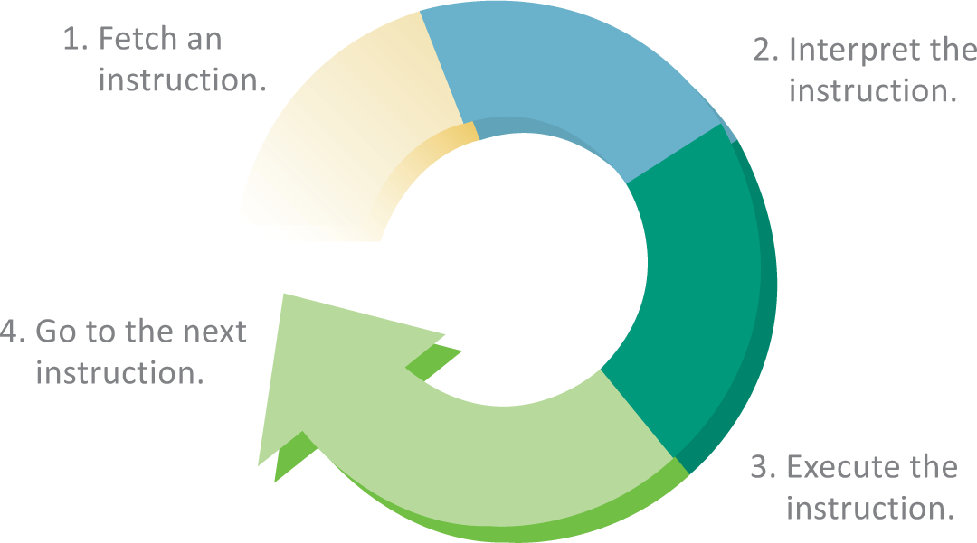
How Processors Work (4 of 6)
The term instruction cycle refers to the process in which a computer executes a single instruction

Slide 57
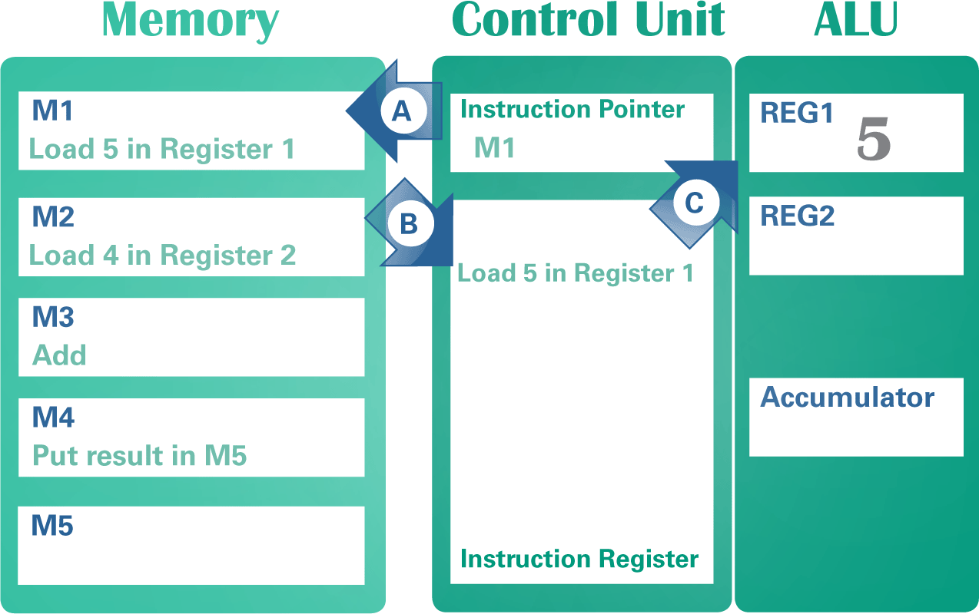
How Processors Work (5 of 6)
Machine language instructions for programs are held in memory; when the program begins, the memory address of the first instruction is placed in a part of the microprocessor’s control unit called an instruction pointer

Slide 58
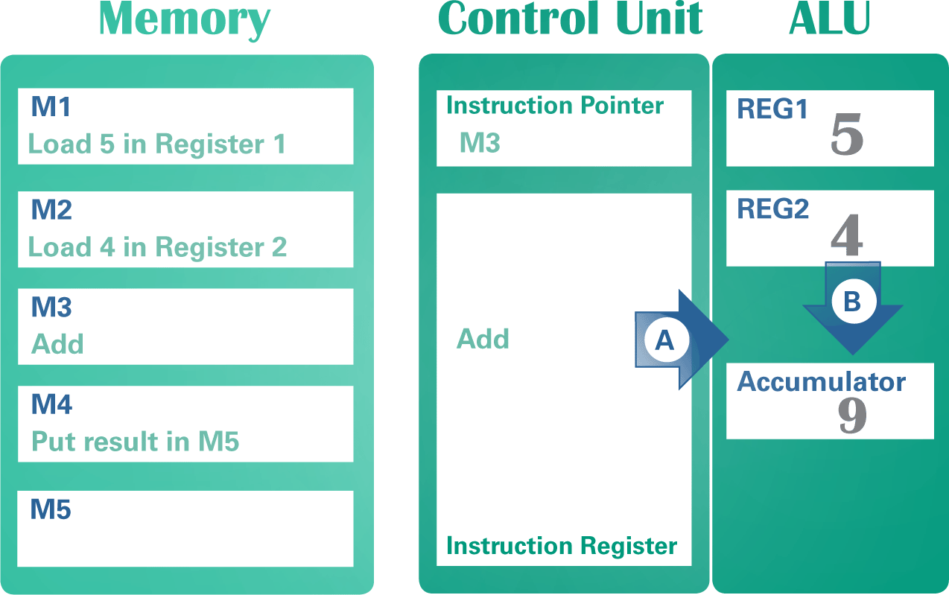
How Processors Work (6 of 6)
The ALU is responsible for performing arithmetic and logical operations

Slide 59
Performance (1 of 5)
A microprocessor’s performance is affected by several factors, including clock speed, number of cores, processing techniques, cache size, word size, and instruction set
A processor specification, such as 3.4 GHz, indicates the speed of the microprocessor clock — a timing device that sets the pace for executing instructions
A cycle is the smallest unit of time in a microprocessor’s universe; every action a processor performs is measured by cycles
Gigahertz (GHz) means a billion cycles per second

Slide 60
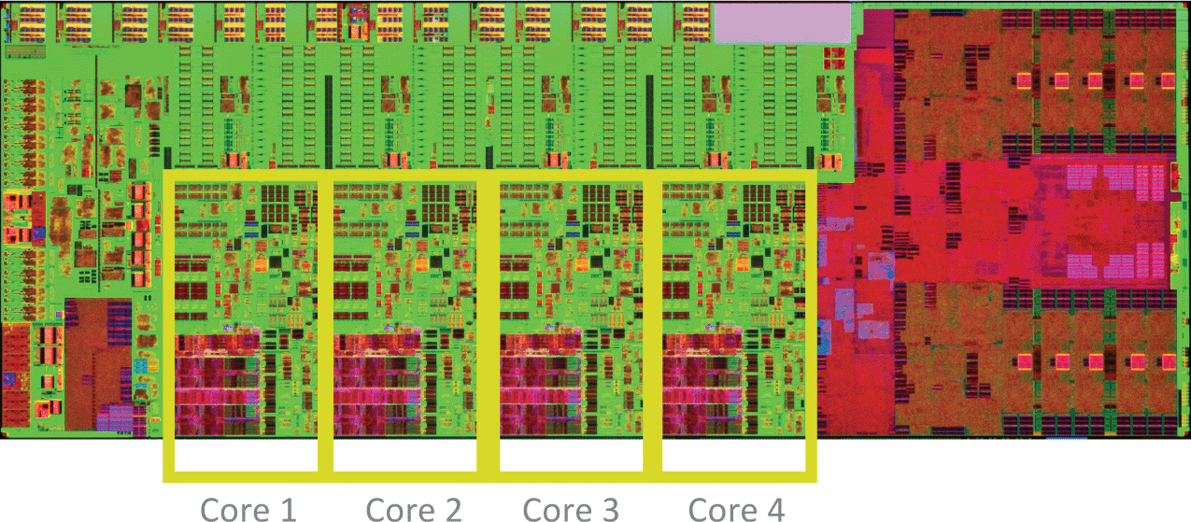
Performance (2 of 5)
A microprocessor that contains circuitry for more than one processing unit is called a multi-core processor

Slide 61
Performance (3 of 5)
Some processors execute instructions “serially” — or one instruction at a time
With serial processing, the processor must complete all steps in the instruction cycle before it begins to execute the next instruction
When a processor begins to execute an instruction before it completes the previous instruction, it is using pipeline processing
Parallel processing executes more than one instruction at a time and works well with today’s multi-core microprocessors

Slide 62
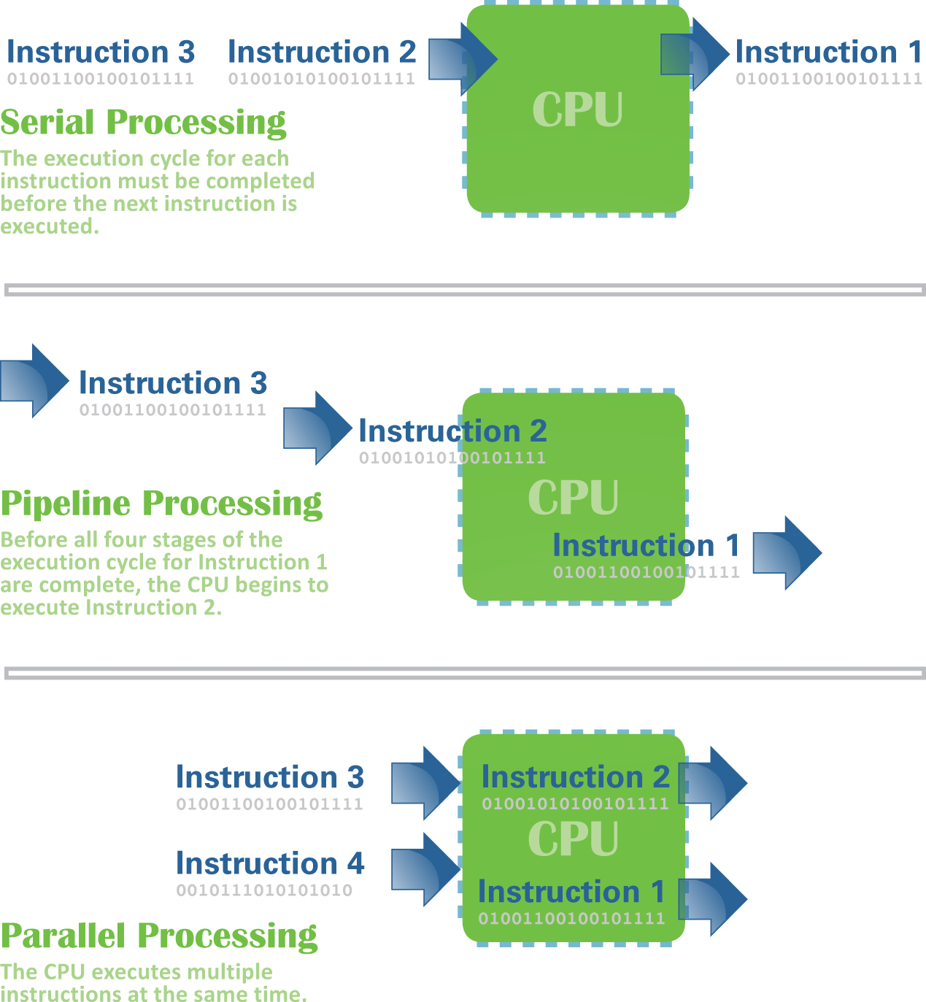
Performance (4 of 5)
Pipeline and parallel processing offer better performance than serial processing

Slide 63
Performance (5 of 5)
What affects performance?
CPU cache (pronounced “cash”) is a special high-speed memory that allows a microprocessor to access data more rapidly
Word size refers to the number of bits that a microprocessor can manipulate at one time; it limits the amount of memory that the processor can access
A RISC (reduced instruction set computer) processor performs instructions faster than a CISC (complex instruction set computer) processor

Slide 64
Random Access Memory
RAM (random access memory) is a temporary holding area for data, application program instructions, and the operating system
Higher RAM capacity adds to the expense of a device
In RAM, microscopic electronic parts called capacitors hold the bits that represent data
Most RAM is volatile, meaning it needs electrical power to hold data

Slide 65
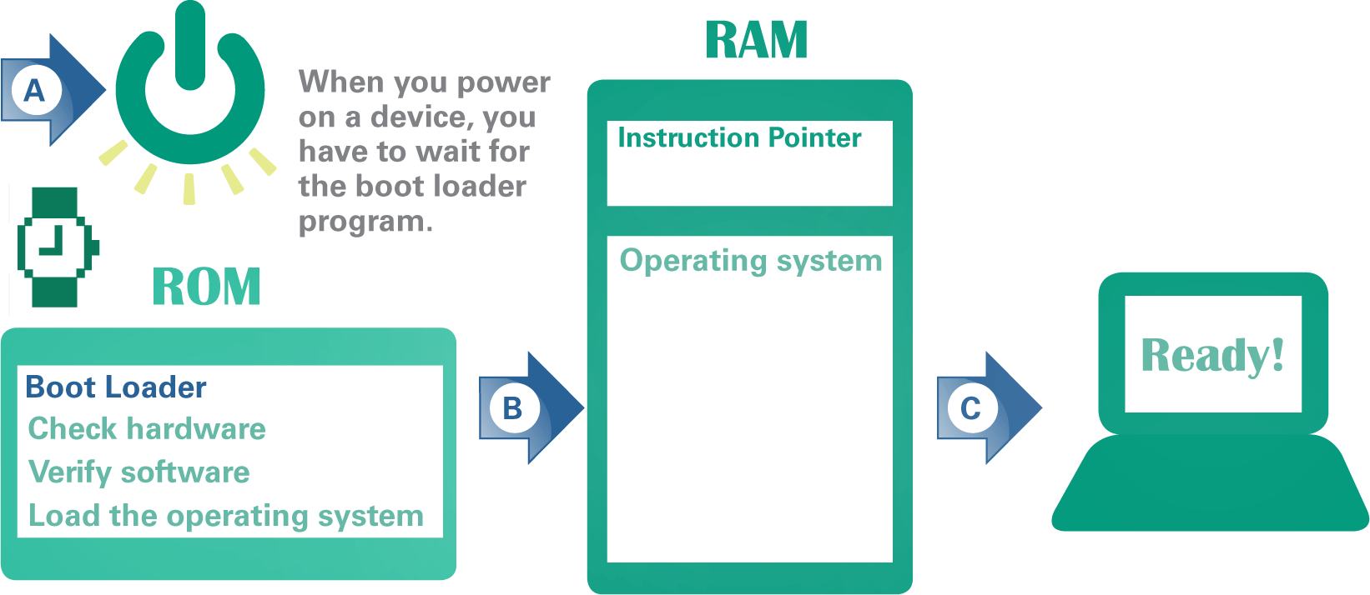
Read-only Memory (1 of 2)
ROM (read-only memory) is a type of memory circuitry that is housed in a single integrated circuit on the system board
ROM contains a small set of instructions and data called the boot loader that tell a digital device how to start

Slide 66
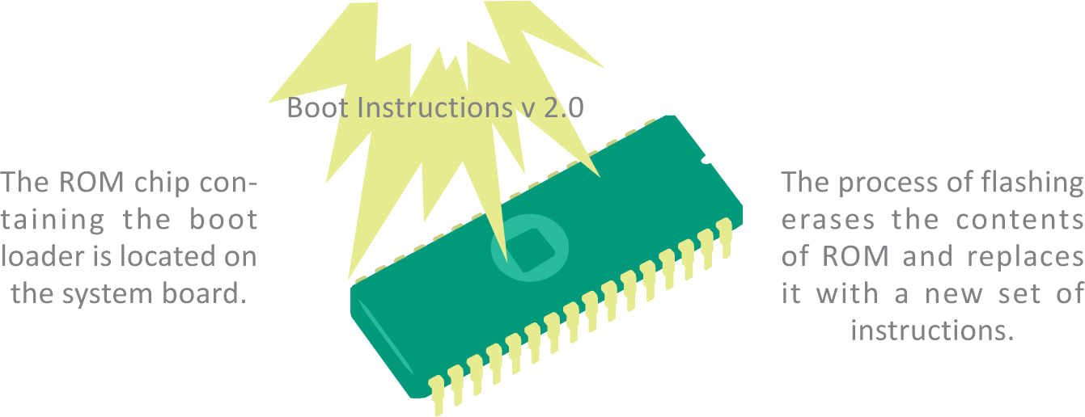
Read-only Memory (2 of 2)
There are several reasons why you might want to change the contents of ROM and boot loader instructions, including:
Repair
User modification
Forensics
Updates

Slide 67
Section D: Storage
Storage Basics
Magnetic Storage Technology
Optical Storage Technology
Solid State Storage Technology
Cloud Storage
Backup

Slide 68
Section D: Objectives (1 of 2)
List five criteria for comparing storage options
Describe the relationship between storage and memory
Identify the technology used for hard disk drives, DVDs, USB drives, and other storage accessories
Interpret the storage specifications given for digital devices
State the advantages and disadvantages of devices that use magnetic storage technology

Slide 69
Section D: Objectives (2 of 2)
Name three types of optical storage media
Explain the significance of ROM, R, and RW for optical storage
Evaluate whether to use local or cloud storage for various projects
List at least four common backup pairings
List four backup tools available to Windows users
Explain the process of restoring a Windows computer after a hard drive failure
Describe the backup options for macOS and iOS devices

Slide 70
Storage Basics (1 of 4)
Storage is a term used for the components of a digital device designed to hold data permanently
A data storage system has two main components: a storage medium and a storage device
Storage medium – the hard drives, CDs, DVDs, flash drives, solid state drives, and memory cards that contains data
Storage device – the mechanical apparatus that records and retrieves data from a storage medium

Slide 71
Storage Basics (2 of 4)
Each storage technology has its advantages and disadvantages, so review its durability, dependability, speed, capacity, and cost before buying
Durability
Resistance to damage from handling and environmental factors such as dust, humidity, heat, and cold. Can be measured in lifespan or in write cycles (the number of times data can be written and revised).
Dependability
Available when needed; not subject to breakdown, malfunction, network outages, or service interruptions. Can be measured by mean time between failures (MTBF is the time a device is expected to function before failing). Cloud storage service dependability can be measured by uptime (the percent of time the service is accessible).

Slide 72
Storage Basics (3 of 4)
Speed
The rate at which data can be stored or accessed. Faster is better. Can be measured by data transfer rate (the number of megabytes per second that are read or written by the storage device).
Capacity
The amount of data that can be stored, usually measured in gigabytes (GB) or terabytes (TB).
Cost
The price of the storage device and media, usually expressed per gigabyte (GB).

Slide 73
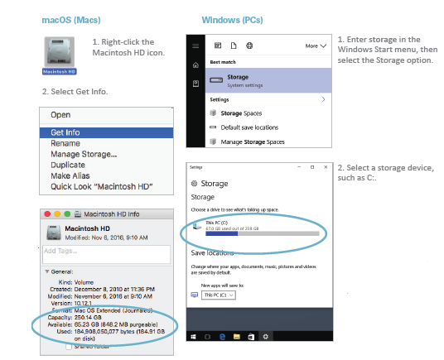
Storage Basics (4 of 4)

Slide 74
Magnetic Storage Technology (1 of 3)
Magnetic storage technology is used for desktop and laptop hard disk drives, as well as the storage devices used in enterprise computing installations and cloud services
Magnetic storage represents data by magnetizing microscopic particles on a disk or tape surface
A hard disk drive contains one or more platters and their associated read-write heads
A hard disk platter is a flat, rigid disk made of aluminum or glass and coated with magnetic iron oxide particles
A read-write head mechanism in the disk drive magnetizes particles to write data, and senses the particles’ polarities to read data

Slide 75
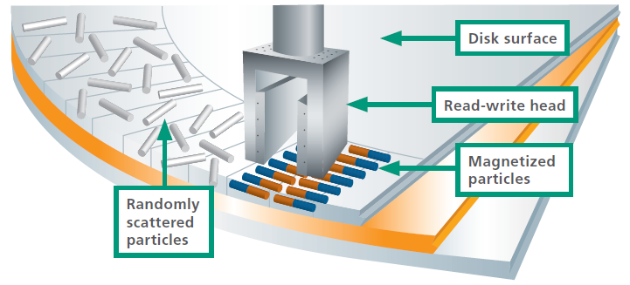
Magnetic Storage Technology (2 of 3)
Before data is stored on a hard disk, particles on the disk surface are scattered in random patterns. The disk drive’s read-write head orients them in a positive (north) or negative (south) direction to represent 0 and 1 bits, respectively.

Slide 76
Magnetic Storage Technology (3 of 3)
Hard disk drive specifications include:
Access time – the average time it takes a computer to locate data on the storage medium and read it
Data transfer rate – the amount of data a storage device can move per second from the storage medium to RAM

Slide 77
Optical Storage Technology (1 of 4)
CD, DVD, and Blu-ray (BD) technologies are classified as optical storage, which represents data as microscopic light and dark spots on the disc surface
An optical drive contains a laser that directs a beam of light toward the underside of the disc
Reflected light is collected by a lens and converted into 0s and 1s that represent data

Slide 78
Optical Storage Technology (2 of 4)
A single optical drive typically handles CDs, DVDs, and Blu-ray discs, but the costs and capacities of these discs vary
CD 650 MB 15 ₵
CD (compact disc): Designed to hold 74 minutes of recorded music, then adapted for computer storage with capacity for 650 MB of data. Later improvements in CD standards increased the capacity to 80 minutes of music or 700 MB of data.

Slide 79
Optical Storage Technology (3 of 4)
DVD 4.7 GB 25 ₵
DVD (digital video disc or digital versatile disc): Designed with the capacity to hold a feature-length film. A single-sided DVD offers 4.7 GB (4,700 MB) of data storage. A double-layer DVD has two recordable layers on the same side and can store 8.5 GB of data.
Blu-ray 25 GB 50₵
Blu-ray (BD): Designed to hold high-definition 1080p video by offering 25 GB storage capacity. The name Blu-ray is derived from the blue-violet colored laser used to read data. DVD technology uses a red laser; CD technology uses a near infrared laser.

Slide 80
Optical Storage Technology (4 of 4)
Optical technologies are grouped into three categories: read-only, recordable, and rewriteable
ROM. Read-only technology stores data permanently on a disc, which cannot be later added to or changed; can potentially store data for 100 years
R. Recordable technology uses a laser to change the color in a dye laser sandwiched beneath the clear plastic disc surface; the laser creates dark spots that are read as pits
RW. Rewritable technology uses phase change technology to alter a crystal structure on the disc surface; altering this structure creates patterns of light and dark spots resembling pits and lands

Slide 81
Solid State Storage Technology (1 of 3)
Solid state storage (sometimes called flash memory) stores data in erasable, rewritable circuitry, rather than on spinning disks or streaming tape
Once the data is stored it is non-volatile, meaning the circuits retain data without an external power source

Slide 82
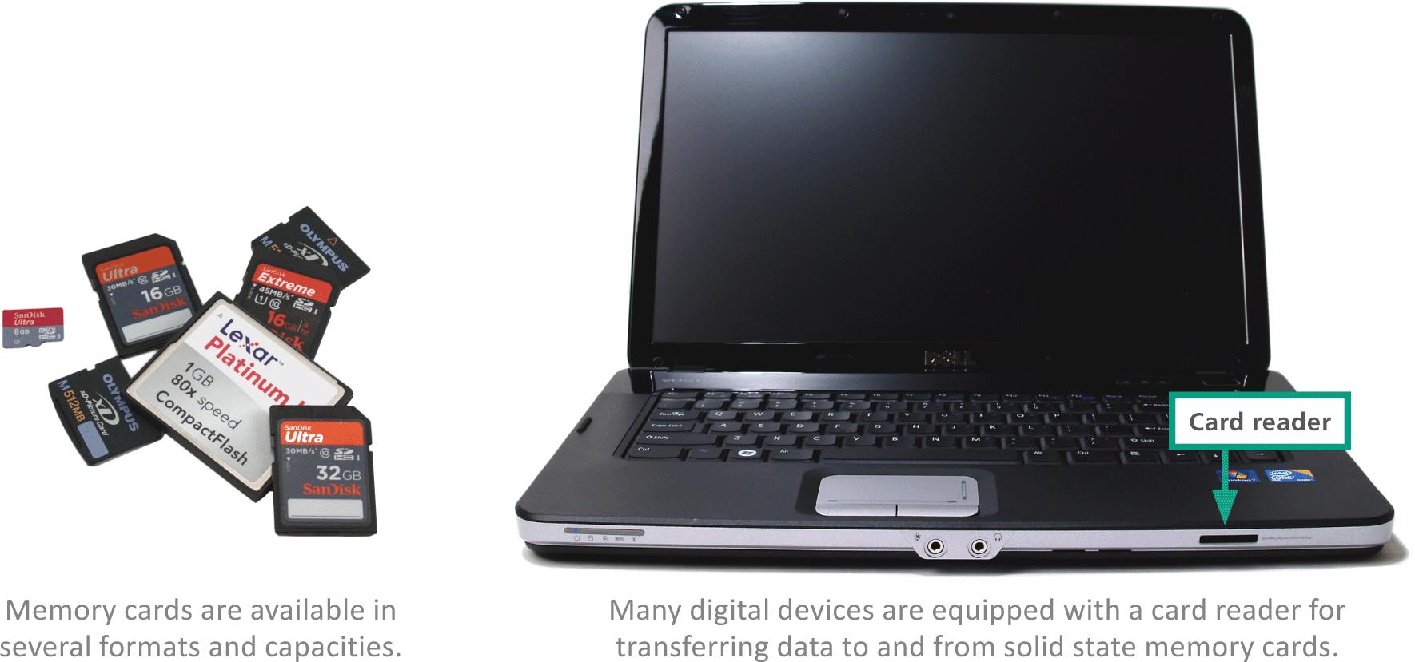
Solid State Storage Technology (2 of 3)
A memory card is a flat, solid state storage medium commonly used to transfer files from digital cameras and media players to computers

Slide 83
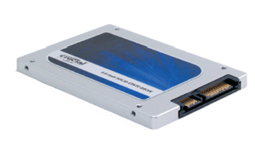
Solid State Storage Technology (3 of 3)
A solid state drive (SSD) is a package of flash memory that can be used as a substitute for a hard disk drive
A USB flash drive is a portable storage device that plugs directly into a computer’s system unit using a built-in USB connector
35₵ cost per GB
SSDs are widely used as the main storage device in smartphones and tablet computers. Some laptops also include an SSD instead of hard disk drive

Slide 84
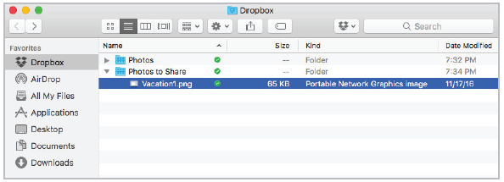
Cloud Storage (1 of 3)
Remote storage is housed on an external device that can be accessed from a network
Remote storage can also be available as an Internet service, in which case it is called cloud storage
Cloud storage is provided to individuals by services such as Apple iCloud, Microsoft OneDrive, Google Drive, and Dropbox

Slide 85
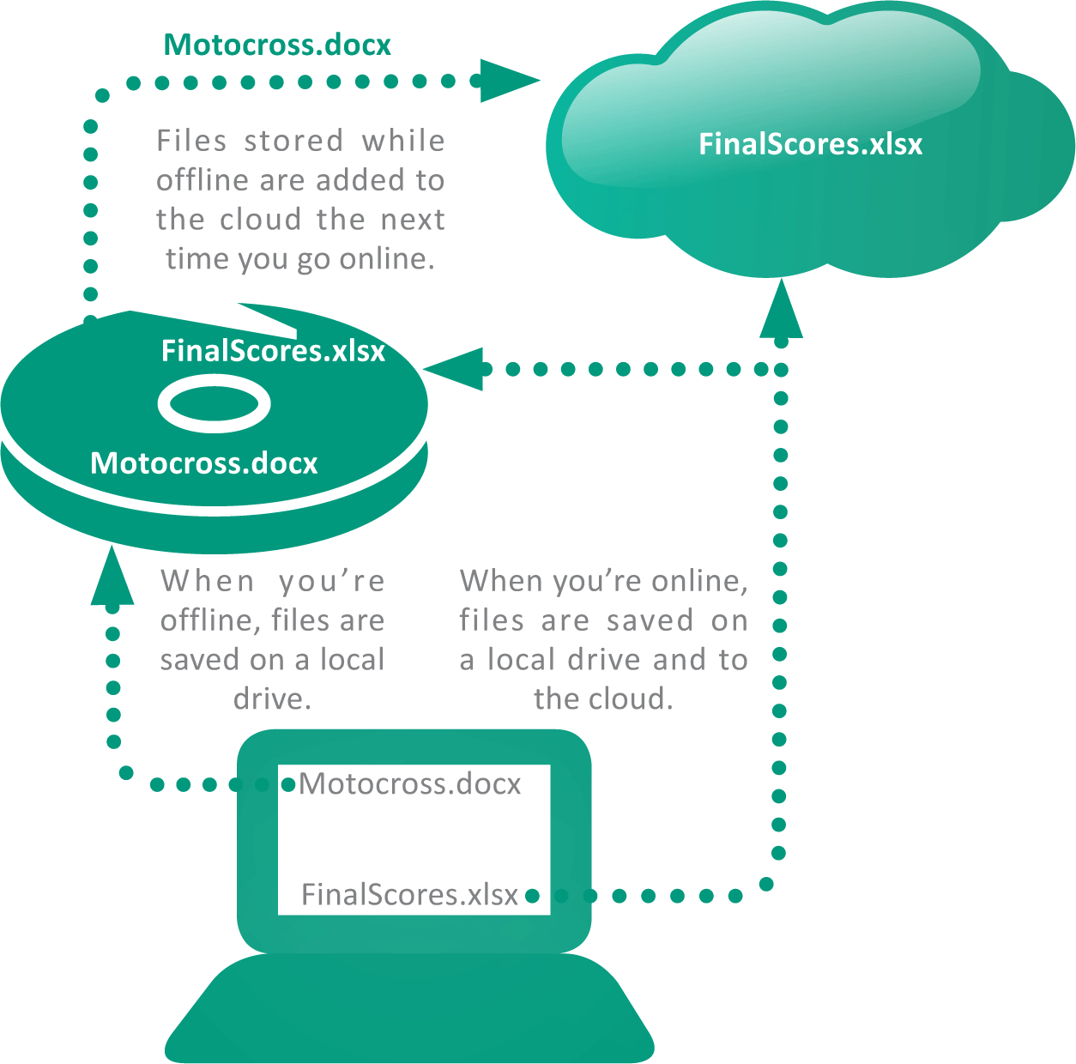
Cloud Storage (2 of 3)
Some cloud implementations offer a synchronization feature that automatically duplicates files stored on a local device by also saving them in the cloud.

Slide 86
Cloud Storage (3 of 3)
Cloud storage basics:
Security and privacy risks – the more places your data is stored and the more networks on which it travels, the more susceptible it becomes to intercepts from hackers and government spying agencies
Service outages – when a cloud storage site has an outage, all the data stored there becomes temporarily inaccessible
Discontinuation of service – some cloud storage providers have closed down their services with little warning

Slide 87
Backup (1 of 6)
A backup is a copy of one or more files that is made in case the originals become damaged or lost
Figuring out what to backup is important; backing up everything isn’t always practical
Operating system: The operating system is required to start your device, but a backup copy might not run if it is unauthorized.
Software: Most devices are populated with preinstalled software, and you’ve probably downloaded and installed many additional apps. If these are wiped out when a storage device fails, the process of downloading and reinstalling them can be time consuming.

Slide 88
Backup (2 of 6)
Data files: Your documents, photos, music, videos—all the goodies that you’ve created and gathered—can be difficult or impossible to reconstruct from scratch.
Settings, accounts, and profiles: How much time did you spend customizing your home screen, entering contacts, choosing passwords, and setting preferences for your favorite apps? No one wants to have to do that all over again!

Slide 89
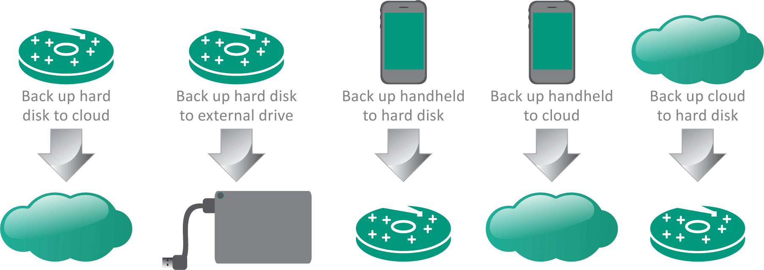
Backup (3 of 6)
When deciding on what to back up, know what’s important and ensure that current versions exist on more than one storage device

Slide 90
Backup (4 of 6)
Tools you’ll need for backups:
Recovery drive (system repair disc) – contains parts of the OS necessary to boot your computer and diagnose system problems
Copy command – allows you to make copies of essential files
File History – allows for automated data backup and file synchronization to make copies of files from your Documents, Music, Picture, Pictures, and Videos folders
System image – Windows includes a disk image option called System Image; a bit-for-bit copy of the data from all sectors of a hard disk

Slide 91
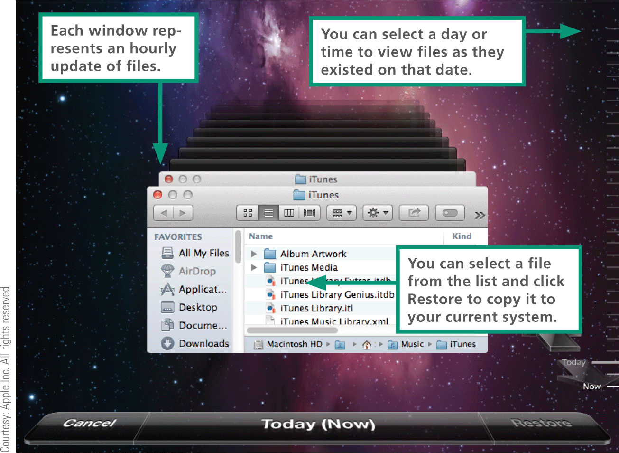
Backup (5 of 6)
MacOS offers a comprehensive file synchronization utility called Time Machine, which backs up the entire hard disk

Slide 92
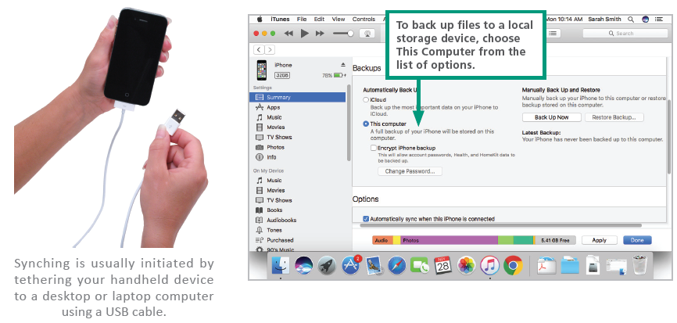
Backup (6 of 6)
Owners of iOS devices can backup to a local computer using iTunes or to iCloud

Slide 93
Section E: Input and Output
Add-on Gadgets
Expansion Ports
Bluetooth
Device Drivers
Display Devices
Printers
Autonomous Vehicles

Slide 94
Section E: Objectives (1 of 2)
Categorize devices as input, output, or mixed
Diagram the path of data from external devices to the CPU
Identify common expansion ports and connectors, such as USB, VGA, HDMI, DVI, DisplayPort, Thunderbolt, and Ethernet
State which types of devices should not be unplugged without notification
List at least three examples of devices that might be connected using Bluetooth

Slide 95
Section E: Objectives (2 of 2)
Explain the purpose of a device driver and why one might have to be installed or updated manually
List four factors that affect display quality
Explain the role of a GPU and list the applications for which one is most useful
Explain how resolution settings affect the size of objects and text on the screen
List five types of sensors that provide input to autonomous vehicles

Slide 96
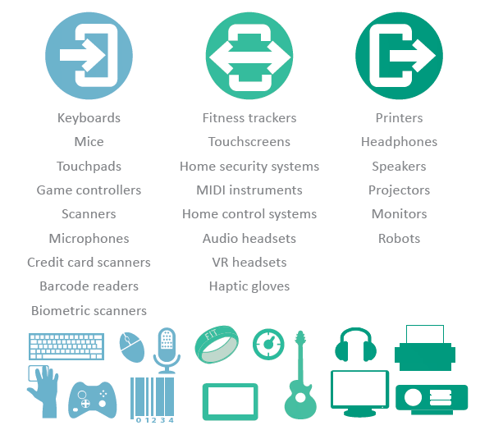
Add-on Gadgets
There are lots of options available for gadgets that accompany your digital devices

Slide 97
Expansion Ports (1 of 3)
Many digital devices have ports in the system unit for connecting cables and various add-ons; these ports are called expansion ports because they expand the options for input, output, and storage
When you plug in a USB flash drive or insert a memory card, you are using an expansion port

Slide 98
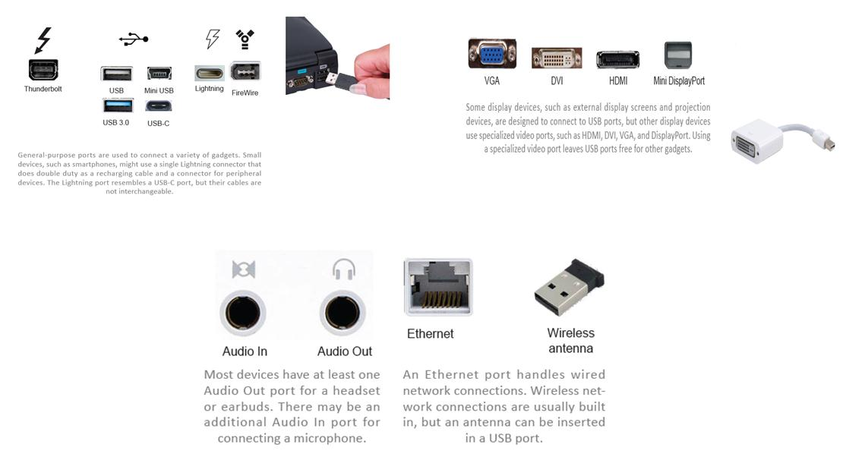
Expansion ports (2 of 3)

Slide 99
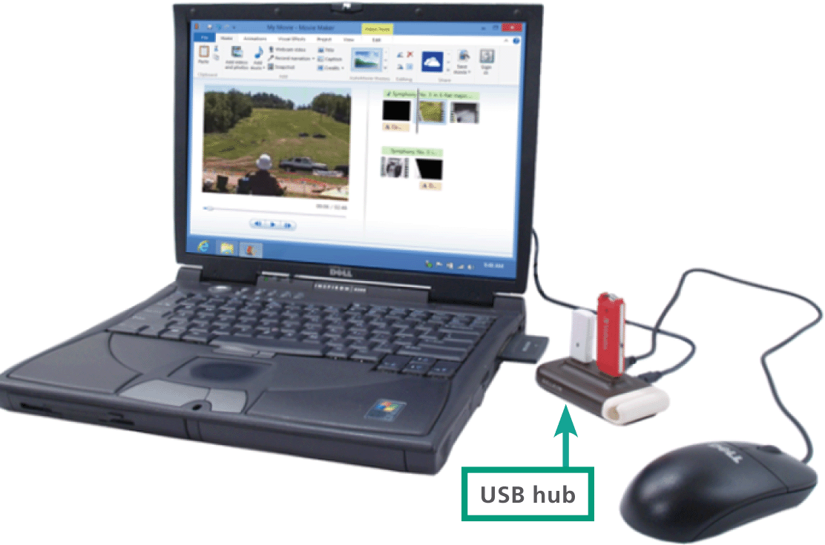
Expansion Ports (3 of 3)
If you want to connect more devices than the available number of USB ports, you can use a USB hub

Slide 100
Bluetooth
A common wireless technology for connecting peripherals is Bluetooth
Bluetooth is a low-power technology, so it is ideal for mobile devices that don’t have big batteries
Bluetooth is used to connect wireless headsets to smartphones and is built into many smartphones, tablets, laptops, and desktops

Slide 101
Device Drivers and Apps
A device driver is software that helps a peripheral device establish communication with its host device
For example, the device driver for an HP printer sets up data streams from RAM to the printer and makes sure that the data is formatted in a way that the printer can work

Slide 102
Display Devices (1 of 6)
A computer display device that simply displays text and images is classified as an output device
Touchscreens, however, can be classified as both input and output devices because they accept input and also display output
LCD (liquid crystal display) technology produces an image by filtering light through a layer of liquid crystal cells

Slide 103
Display Devices (2 of 6)
Factors that affect image quality are:
Screen size – the measurement in inches from one corner of the screen diagonally across to the opposite corner
Response rate – the time it takes for one pixel to change from black to white then back to black
Dot pitch (dp) – the LED’s that form an image on the screen are spaced in a grid; dp is the distance in millimeters between like-colored LEDs
Screen resolution – the number of horizontal and vertical pixels that a device displays on the screen

Slide 104
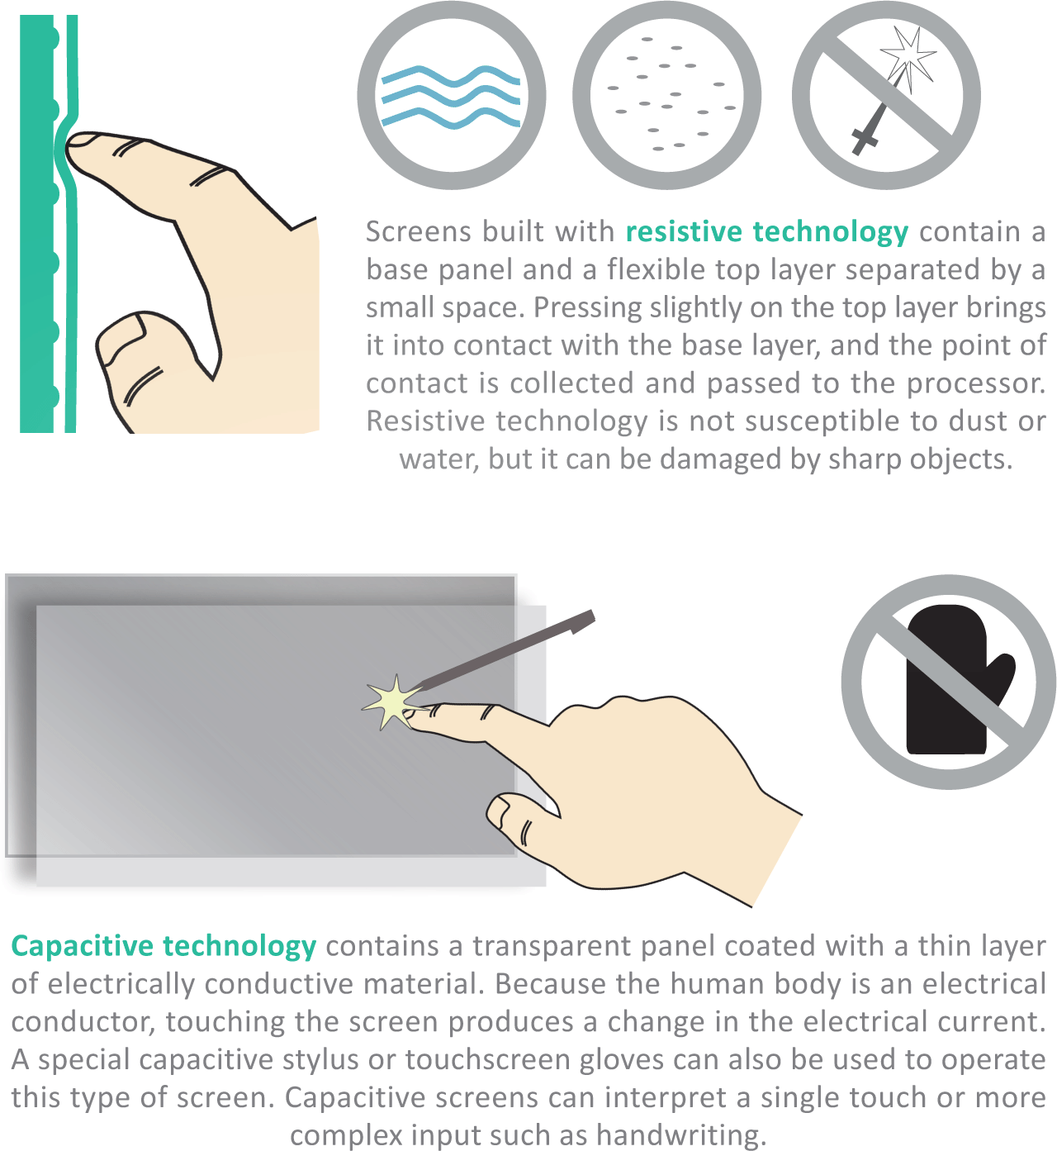
Display Devices (3 of 6)
Tablet computers, handheld devices, retail store self-checkouts, and ATMs display output and collect input from a touchscreen
They can also display a virtual keyboard for devices that are not connected to a physical keyboard

Slide 105
Display Devices (4 of 6)
Display devices require graphics circuitry to generate and transport the signals for displaying an image on the screen
One type of graphics circuitry, referred to as integrated graphics, is built into a computer’s system board

Slide 106
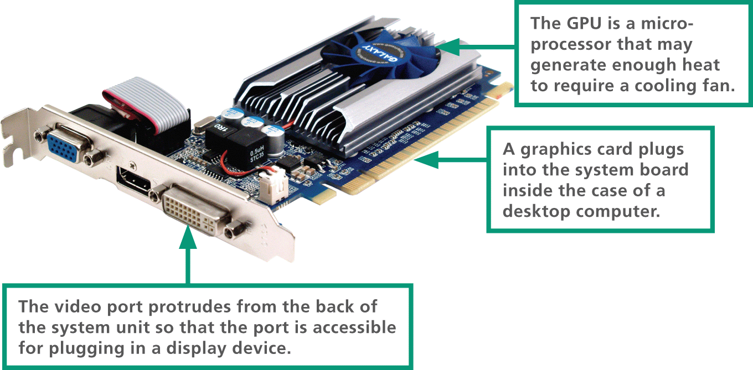
Display Devices (5 of 6)
A second option, called dedicated graphics, is graphics circuitry mounted on a small circuit board called a graphics card (or video card)

Slide 107
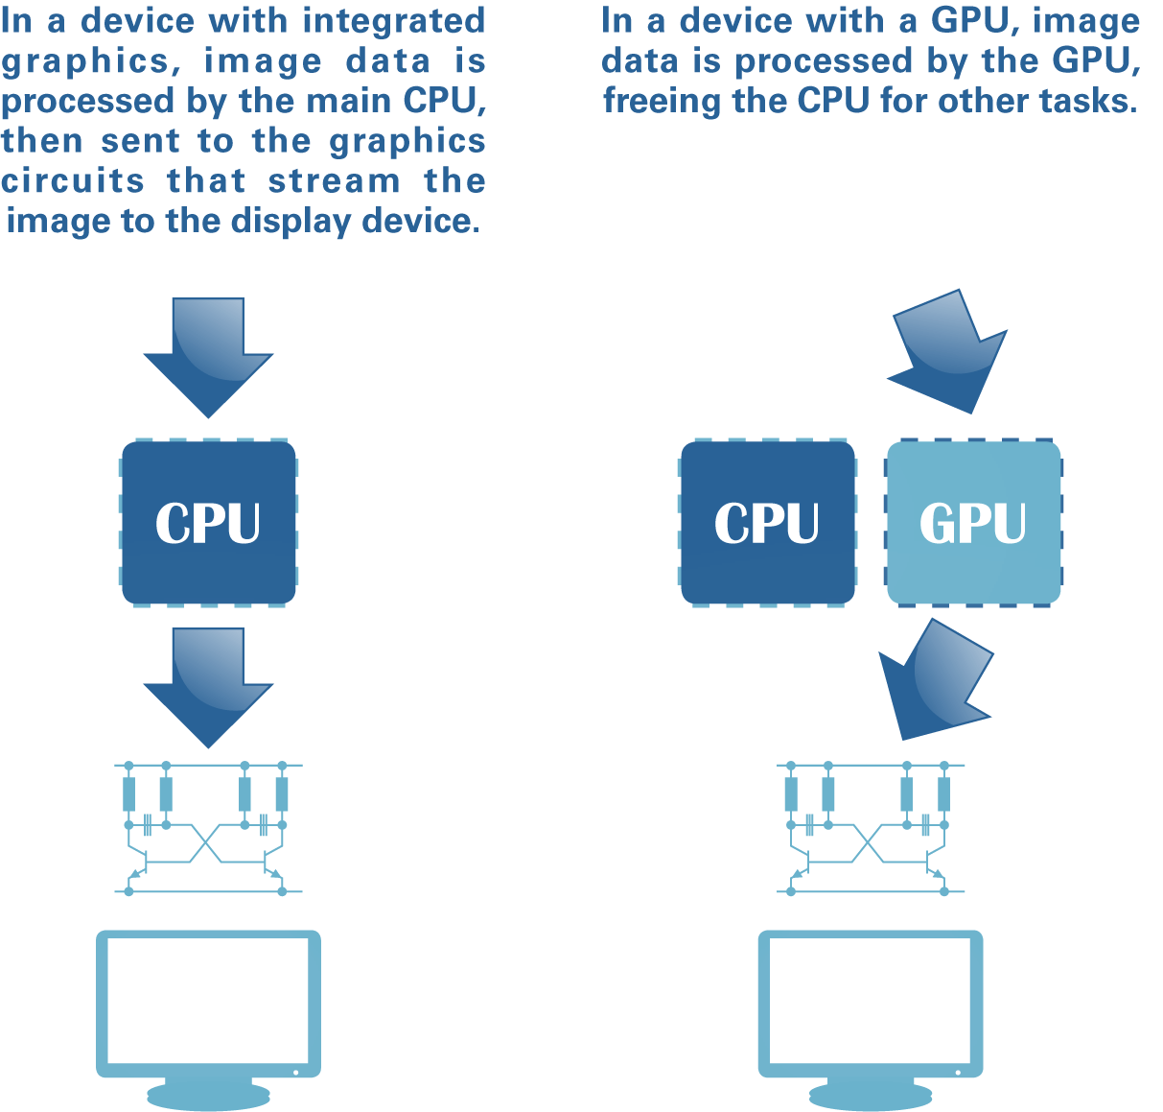
Display Devices (6 of 6)
A graphics card contains a graphics processing unit (GPU) and a special video memory, which stores screen images as they are processed but before they are displayed

Slide 108
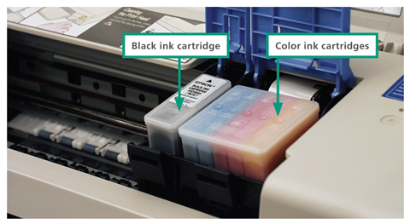
Printers
Today’s best-selling multifunction printers use ink jet or laser technology and can also serve as scanners, copiers, and fax machines
An ink jet printer has a nozzle-like print head that sprays ink onto paper to form characters and graphics
Most ink jet printers use CMYK color, which requires only cyan (blue), magenta (pink), yellow, and black inks to create a printout that appears to contain thousand of colors.

Slide 109
Things (1 of 3)
The utopian vision for the Internet of Things (IoT) is a busy hive of smart sensors that work behind the scenes to collect data and use it to improve just about anything
Sound
“A window on your house just broke.”
“Your dog is barking.”
“The club is busy (noisy).”
GPS
“Your dog is out of your yard.”
“Your car is not in your driveway.”
“You hiked a 2.5-mile circuit.”

Slide 110
Things (2 of 3)
Motion
“A person or animal approached your cabin last night.”
“Your cat is at the litter box.”
Light
“It’s 10 pm; your porch light isn’t on.”
“Do you want to dim the lights?”
“Your UV exposure has reached the limit.”
Water
“Your basement floor seems to be wet.”
“Your swimming pool needs more chlorine.”
“Your plant needs water.”

Slide 111
Things (3 of 3)
Contact
“Your front door isn’t locked.”
“Your doorbell just rang.”
“Your child just got home from school.”
Accelerometer
“You’ve walked 10,000 steps today.”
“The baggage handlers just dropped your suitcase.”
Temperature
“Your oven is on.”
“Your apartment is unusually hot.”
“It’s below zero; remote start your car.”

Slide 112
Autonomous Vehicles (1 of 9)
Cars, trucks, trains, drones, planes, and machines that are usually piloted by humans become autonomous as the vehicles, rather than the humans, take over control of speed, braking, and steering
In general, autonomous vehicles use sense-plan-act algorithms that emerged with the development of robotic systems
Sense-plan-act algorithms gather data, analyze it, and then carry out the required actions
Multiple sense-plan-act loops operate simultaneously

Slide 113

Autonomous Vehicles (2 of 9)

Slide 114
Autonomous Vehicles (3 of 9)
Sense
Sensors on the vehicle gather raw data about the nearby environment and the status of the vehicle itself. Environmental data comes from sensing nearby vehicles, people, animals, and other objects, as well as the roadway itself. Vehicle status data includes speed, direction, angle, and altitude. Sensor data is delivered to an onboard computer, where software quickly processes the input to identify road hazards and navigational points.

Slide 115
Autonomous Vehicles (4 of 9)
Plan
Based on its interpretation of sensor data, the onboard computer applies a series of rules to determine the best course of action. For example, if radar data indicates that the vehicle ahead is slowing down, the computer must decide whether to adjust its speed or change lanes. The decision is based on rules such as “If the vehicle ahead slows down gradually, and the left lane is clear, then move to the left lane.”

Slide 116
Autonomous Vehicles (5 of 9)
Act.
After the computer determines a course of action, it sends signals to the vehicle’s control systems. A signal to the car’s steering system can initiate a lane change. Signals could also be sent to the car’s throttle or braking system to achieve a change in speed.

Slide 117
Autonomous Vehicles (6 of 9)
Lidar (light detection and radar) is a key input for the computer algorithms that steer an autonomous vehicle, but radar, sonar, infrared, GPS, cameras, and internal navigation systems also supply essential data

Slide 118
Autonomous Vehicles (7 of 9)
Lidar systems determine distance to obstacles using laser range finders. This device calculates the distance to objects based on the time it takes for the laser beam to reach an object and return. The range for this device is about 650 feet (200 meters), and 360-degree Lidar arrays can gather millions of data points per second to map objects in a 65-foot radius of the vehicle.
Radar adds more data about the nearby environment. Radar, which uses sound waves, does a good job of sensing metallicobjects, but does not sense pedestrians and other non-metallic objects. It is primarily used to track nearby vehicles. It is currently used in adaptive cruise control systems to maintain a safe distance to the car in front.

Slide 119
Autonomous Vehicles (8 of 9)
GPS uses orbiting satellites to determine a vehicle’s position. The coordinates received from the GPS are cross-referenced with digital road maps. Civilian GPS is accurate to about ten feet, but augmentation technology improves location accuracy. Soon, augmented GPS systems should be able to calculate position with accuracy of one inch.
Infrared sensors can be used to sense the heat signatures of pedestrians and animals, particularly when it is dark.
Internal navigation systems (INS) include gyroscopes and accelerometers that continuously calculate position, orientation, and speed of the vehicle.

Slide 120
Autonomous Vehicles (9 of 9)
These systems can monitor position if GPS signals are temporarily blocked by the structures in a dense urban area.
Cameras collect images of road signs and traffic signals, which are analyzed by image recognition software.

